Slide 1

Intro to Unity – Using Github
By: Jeremy nIELSON

Slide 2
Initial Requirements
Make sure you have setup and created your GitHub account
Ensure you have a terminal to use git.
Git for Windows: https://gitforwindows.org/
Git LFS: https://git-lfs.github.com/
Familiarize yourself with basic git commands

Slide 3
Using a .gitignore
This file ensures that certain user-specified files or directories are not committed to GitHub.
All projects should have a .gitignore/readme
A standard unity .gitignore can be found here
The .gitignore we will use can be found in the part 1 project folder

Slide 4
Using a .gitattributes
This file keeps track of all the file types that Unity supports.
Be sure that both the .gitignore and .gitattributes files are in the base of your project folders

Slide 5
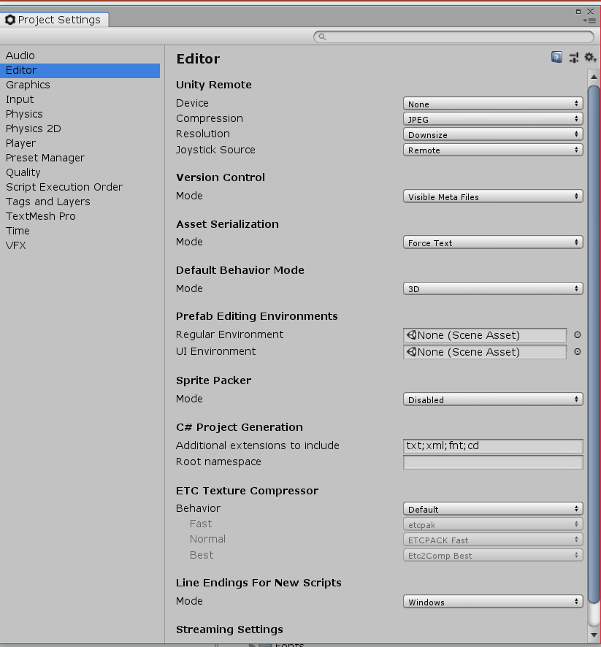
Setup Unity – Version Control
In your project:
Edit > Project settings > Editor
Under Version Control: Mode (Visible Meta Files)
Asset Serialization: Mode (Force Text)
Save changes

